Slide 1
UPPER SIXTH ARTS
GEOGRAPHY
Practical Work 1
Techniques of Mapping Population Distribution and Density
Notes:
Good morning, class, and welcome to our geography lesson. I am your geography teacher, Mr Kamdem. Today we are starting Practical Work 1: Techniques of Mapping Population Distribution and Density.

Slide 2
CLASS INFO
Class, Chapter and Duration
Class | Upper Sixth Arts
Chapter | Module 4: Understanding and managing population dynamics across the world in general and Cameroon in particular
Duration | 2 periods (2 × 50 minutes)
Notes:
This lesson is for Upper Sixth Arts. It belongs to Module 4: Understanding and managing population dynamics across the world in general and Cameroon in particular. We shall need 2 periods to cover it.

Slide 3
IDENTIFICATION
Lesson Identification
Topic | Population Numbers
Sub-topic | Population Density and Distribution
Lesson | Practical Work 1: Techniques of Mapping Population Distribution and Density
Notions / Concepts | Dot map, choropleth map, Lorenz curve, density lapse rate.
Syllabus focus | Dot and choropleth maps; the Lorenz curve; population density lapse rates; advantages and disadvantages.
Competence | Learners are able to map population distribution and density and assess each method.
Notes:
Our topic is Population Numbers, and the sub-topic is Population Density and Distribution. The key notions we shall use today are: dot map, choropleth map, Lorenz curve, density lapse rate. At the end, you should be able to do this: learners are able to map population distribution and density and assess each method.

Slide 4

HOMEWORK CORRECTION
Correction of the Homework
Question (Lesson 2: Population Distribution and Density):
Find the population and area of your region and calculate its density.
Notes:
Before we start the new lesson, let us correct the homework I gave you at the end of Lesson 2: Population Distribution and Density. The question was: Find the population and area of your region and calculate its density. Take out your exercise books.

Slide 5
HOMEWORK CORRECTION
Correction: Possible Answer
North Region (example): population about 2.5 million, area about 66,000 km², density ≈ 2,500,000 ÷ 66,000 ≈ 38 people per km².
Notes:
Here is a good answer. North Region (example): population about 2.5 million, area about 66,000 km², density ≈ 2,500,000 ÷ 66,000 ≈ 38 people per km². Compare it with your own answer and correct your work in red.

Slide 6
LESSON PLAN
Lesson Plan
Correction of the homework
Objectives and recall
Real-life situation and action to take
Learning activities
Board summary
Evaluation, remediation and homework
Notes:
Here is the plan of our lesson today. First, we shall correct the homework. Then we shall look at the objectives and recall what you already know. After that, we shall study a situation from real life and the action to take, and do the learning activities. Finally, we shall copy the board summary, do the evaluation and the remediation, and I will give you the homework.

Slide 7
OBJECTIVES
Objectives
By the end of this lesson, you should be able to:
Draw and read dot and choropleth maps.
Draw and interpret a Lorenz curve.
Interpret a density lapse graph and assess the methods.
Notes:
By the end of this lesson, you should be able to do three things. Number 1: draw and read dot and choropleth maps. Number 2: draw and interpret a Lorenz curve. Number 3: interpret a density lapse graph and assess the methods.

Slide 8
PREVIOUS KNOWLEDGE
Previous Knowledge
Density = people ÷ area.
The Littoral is the most crowded region.
Notes:
Let us first remember what you already know. Density = people ÷ area. The Littoral is the most crowded region. Keep this in mind, because we shall build on it today.

Slide 9
REAL-LIFE SITUATION
Situation in Real Life
The Regional Delegate of Planning wants a single page that shows where people live in Cameroon. The class must choose the best way to map the data.
Notes:
Listen carefully to this situation from real life. The Regional Delegate of Planning wants a single page that shows where people live in Cameroon. The class must choose the best way to map the data. Think about it, because I am going to ask you some questions.

Slide 10
REAL-LIFE SITUATION
Situation: Question 1
What is the problem in the situation?
Notes:
Question 1: What is the problem in the situation? Think for a moment, then raise your hand to answer.

Slide 11
REAL-LIFE SITUATION
Answer
The class must choose a way to map population.
Notes:
Good. The class must choose a way to map population.

Slide 12
REAL-LIFE SITUATION
Situation: Question 2
Name two mapping methods.
Notes:
Question 2: Name two mapping methods. Think for a moment, then raise your hand to answer.

Slide 13
REAL-LIFE SITUATION
Answer
Dot map and choropleth map.
Notes:
Good. Dot map and choropleth map.

Slide 14
REAL-LIFE SITUATION
Situation: Question 3
Which graph shows how unequal the distribution is?
Notes:
Question 3: Which graph shows how unequal the distribution is? Think for a moment, then raise your hand to answer.

Slide 15
REAL-LIFE SITUATION
Possible Answer
The Lorenz curve.
Notes:
Good. The Lorenz curve.

Slide 16
ACTION TO TAKE
Action to Take
Map population data to show where people live.
Notes:
From this situation, the action we are working towards in this lesson is the following: map population data to show where people live.

Slide 17
JUSTIFICATION
Justification of the Lesson
This practical work helps us to show population data clearly on maps and graphs.
Notes:
Why is this lesson important for you? This practical work helps us to show population data clearly on maps and graphs.

Slide 18
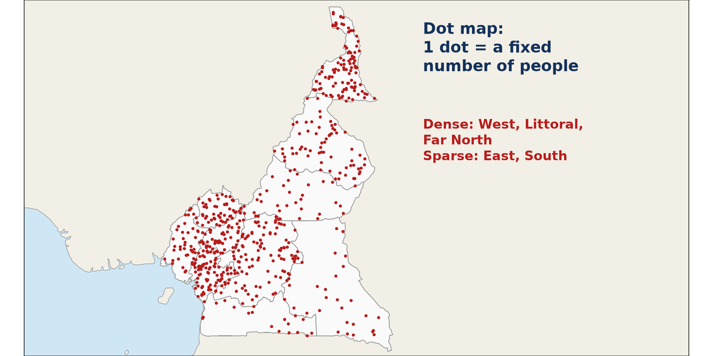
1. DOT MAPS
Activity 1
A dot map of Cameroon.
Notes:
Activity 1. Look carefully at this diagram: a dot map of Cameroon. Observe every detail before I ask the question.

Slide 19
1. DOT MAPS
Activity 1: Question
What does each dot represent? Where are dots closest together?
Notes:
Here is the question for Activity 1: What does each dot represent? Where are dots closest together? Take one minute to think and write your answer in your rough notebook.

Slide 20
1. DOT MAPS
Activity 1: Answer
A fixed number of people; in the West, Littoral and Far North.
Notes:
Let us check the answer together. A fixed number of people; in the West, Littoral and Far North.

Slide 21

1. CHOROPLETH MAPS
Activity 2
A choropleth map of density.
Notes:
Activity 2. Look carefully at this diagram: a choropleth map of density. Observe every detail before I ask the question.

Slide 22
1. CHOROPLETH MAPS
Activity 2: Question
How is a choropleth map made?
Notes:
Here is the question for Activity 2: How is a choropleth map made? Take one minute to think and write your answer in your rough notebook.

Slide 23
1. CHOROPLETH MAPS
Activity 2: Answer
Each area is shaded according to its density class; darker means denser.
Notes:
Let us check the answer together. Each area is shaded according to its density class; darker means denser.

Slide 24
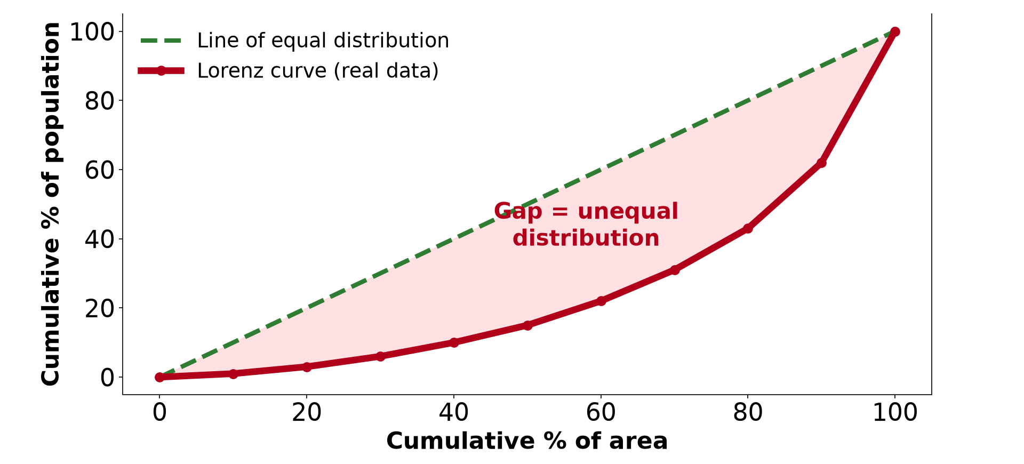
2. THE LORENZ CURVE
Activity 3
A Lorenz curve.
Notes:
Activity 3. Look carefully at this diagram: a Lorenz curve. Observe every detail before I ask the question.

Slide 25
2. THE LORENZ CURVE
Activity 3: Question
What does a curve far from the diagonal show?
Notes:
Here is the question for Activity 3: What does a curve far from the diagonal show? Take one minute to think and write your answer in your rough notebook.

Slide 26
2. THE LORENZ CURVE
Activity 3: Answer
A very unequal distribution of population.
Notes:
Let us check the answer together. A very unequal distribution of population.

Slide 27
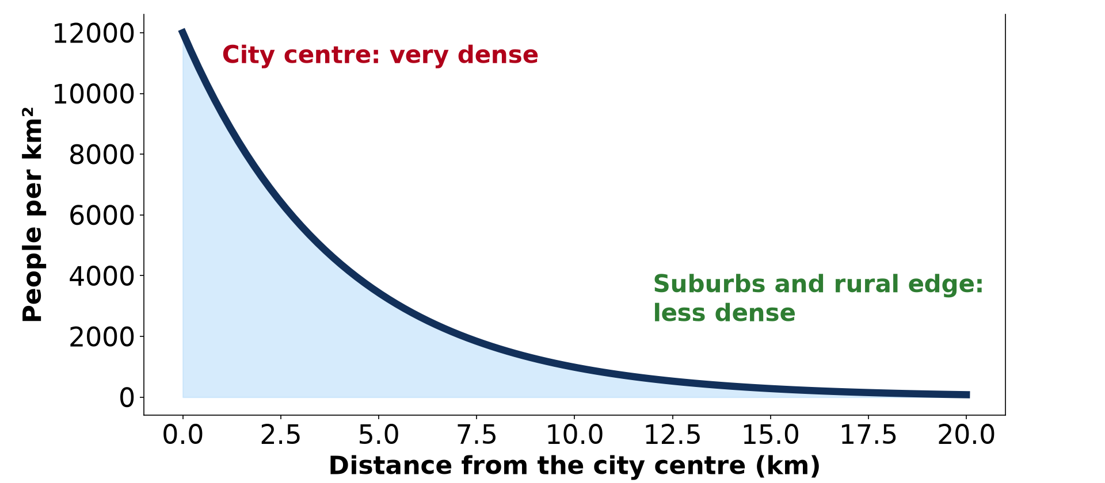
3. POPULATION DENSITY LAPSE RATE
Activity 4
Density falls with distance from a city centre.
Notes:
Activity 4. Look carefully at this diagram: density falls with distance from a city centre. Observe every detail before I ask the question.

Slide 28
3. POPULATION DENSITY LAPSE RATE
Activity 4: Question
What happens to density as we move away from the centre?
Notes:
Here is the question for Activity 4: What happens to density as we move away from the centre? Take one minute to think and write your answer in your rough notebook.

Slide 29
3. POPULATION DENSITY LAPSE RATE
Activity 4: Answer
It falls quickly, then slowly.
Notes:
Let us check the answer together. It falls quickly, then slowly.

Slide 30
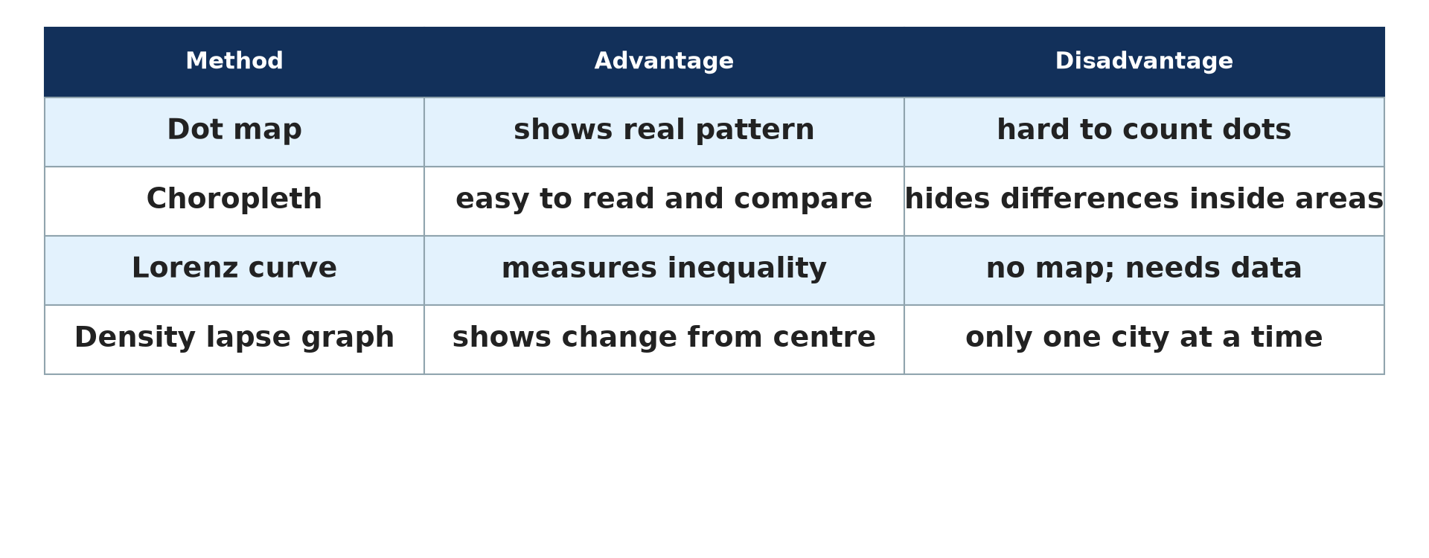
4. ASSESSMENT
Activity 5
Advantages and disadvantages of each method.
Notes:
Activity 5. Look carefully at this diagram: advantages and disadvantages of each method. Observe every detail before I ask the question.

Slide 31
4. ASSESSMENT
Activity 5: Question
Give one weakness of a choropleth map.
Notes:
Here is the question for Activity 5: Give one weakness of a choropleth map. Take one minute to think and write your answer in your rough notebook.

Slide 32
4. ASSESSMENT
Activity 5: Answer
It hides differences inside each area.
Notes:
Let us check the answer together. It hides differences inside each area.

Slide 33
BOARD SUMMARY
Board Summary
Topic: Population Numbers
Sub-topic: Population Density and Distribution
Practical Work 1: Techniques of Mapping Population Distribution and Density
Notes:
Now we are going to copy the board summary. Write the title and the headings neatly in your notebooks. I will give you enough time for each slide, so do not rush.

Slide 34
BOARD SUMMARY
DEFINITIONS
The key terms of this lesson are defined as follows:
Dot map: It is a map where each dot represents a fixed number of people.
Choropleth map: It is a map where areas are shaded according to their density.
Notes:
Let us copy the definitions. The key terms of this lesson are defined as follows. On this slide we have Dot map and Choropleth map. Write each point on a new line, with the key term first, and explain it in your own words when we revise. When you finish, we go to the next slide.

Slide 35
BOARD SUMMARY
DEFINITIONS (continued)
Lorenz curve: It is a graph that shows how unevenly a population is distributed.
Notes:
We continue with the definitions. On this slide we have Lorenz curve. Write each point on a new line, with the key term first, and explain it in your own words when we revise.

Slide 36
BOARD SUMMARY
1. Methods of Mapping Population
Distribution and density can be mapped as follows:
Dot maps: Choose a value for each dot (e.g. 1 dot = 10,000 people) and place the dots where people live. They show distribution clearly.
Notes:
Let us copy Methods of Mapping Population. Distribution and density can be mapped as follows. On this slide we have Dot maps. Write each point on a new line, with the key term first, and explain it in your own words when we revise. When you finish, we go to the next slide.

Slide 37
BOARD SUMMARY
1. Methods of Mapping Population (continued)
Choropleth maps: Calculate density for each area, choose classes and shade darker for higher densities. They show density by administrative region.
Notes:
We continue with Methods of Mapping Population. On this slide we have Choropleth maps. Write each point on a new line, with the key term first, and explain it in your own words when we revise.

Slide 38
BOARD SUMMARY
1. Methods of Mapping Population
Illustration: a dot map
Notes:
Now draw this illustration in your notebook: a dot map. Give it a title and label it clearly.

Slide 39
BOARD SUMMARY
2. The Lorenz Curve and Density Lapse Rate
Uneven distribution can be measured as follows:
Lorenz curve: Rank the areas, then plot the cumulative % of area against the cumulative % of population. The further the curve is from the diagonal, the more unequal the distribution.
Notes:
Let us copy The Lorenz Curve and Density Lapse Rate. Uneven distribution can be measured as follows. On this slide we have Lorenz curve. Write each point on a new line, with the key term first, and explain it in your own words when we revise. When you finish, we go to the next slide.

Slide 40
BOARD SUMMARY
2. The Lorenz Curve and Density Lapse Rate (continued)
Density lapse rate: In a town, density usually decreases from the centre to the edge. A graph of density against distance shows this lapse.
Notes:
We continue with The Lorenz Curve and Density Lapse Rate. On this slide we have Density lapse rate. Write each point on a new line, with the key term first, and explain it in your own words when we revise.

Slide 41
BOARD SUMMARY
2. The Lorenz Curve and Density Lapse Rate
Illustration: a Lorenz curve
Notes:
Now draw this illustration in your notebook: a Lorenz curve. Give it a title and label it clearly.

Slide 42
BOARD SUMMARY
3. Assessment of these Methods
Each method has advantages and disadvantages:
Dot maps: They show real distribution, but dots are hard to count and to place accurately. Very dense areas become black.
Notes:
Let us copy Assessment of these Methods. Each method has advantages and disadvantages. On this slide we have Dot maps. Write each point on a new line, with the key term first, and explain it in your own words when we revise. When you finish, we go to the next slide.

Slide 43
BOARD SUMMARY
3. Assessment of these Methods (continued)
Choropleth maps: They are easy to read and compare, but they suggest sudden changes at boundaries. They hide differences inside each area.
Lorenz curve: It measures inequality precisely, but it does not show where people live. It needs accurate data.
Notes:
We continue with Assessment of these Methods. On this slide we have Choropleth maps and Lorenz curve. Write each point on a new line, with the key term first, and explain it in your own words when we revise.

Slide 44
BOARD SUMMARY
3. Assessment of these Methods
Illustration: comparison of methods
Notes:
Now draw this illustration in your notebook: comparison of methods. Give it a title and label it clearly.

Slide 45
FORMATIVE EVALUATION
Evaluation 1
What does a Lorenz curve close to the diagonal show?
Notes:
Now let us check what you have understood. Question 1: What does a Lorenz curve close to the diagonal show? Answer in your exercise book.

Slide 46
FORMATIVE EVALUATION
Expected Answer
An even distribution of population.
Notes:
The expected answer is: an even distribution of population. If you got it right, well done.

Slide 47
FORMATIVE EVALUATION
Evaluation 2
Give one advantage and one disadvantage of a dot map.
Notes:
Now let us check what you have understood. Question 2: Give one advantage and one disadvantage of a dot map. Answer in your exercise book.

Slide 48
FORMATIVE EVALUATION
Expected Answer
Advantage: shows the real pattern. Disadvantage: hard to count dots.
Notes:
The expected answer is: advantage: shows the real pattern. Disadvantage: hard to count dots. If you got it right, well done.

Slide 49
REMEDIATION
Remediation
Fill in the blanks:
A map with shaded areas is a ______ map.
Inequality is shown by a ______ curve.
Density usually ______ away from a city centre.
Notes:
For those who need more practice, fill in the blanks in your exercise book. The answers are: number 1, choropleth; number 2, Lorenz; number 3, falls.

Slide 50
HOMEWORK
Homework
Using the density figures of the ten regions, draw a choropleth map of Cameroon with four classes.
Notes:
For your homework: Using the density figures of the ten regions, draw a choropleth map of Cameroon with four classes. We shall correct it at the beginning of our next lesson.

Slide 51
NEXT LESSON
Next Lesson
Our next lesson will be on:
Lesson 3: Spatial Population Distribution and its Factors
Notes:
Our next lesson will be on Lesson 3: Spatial Population Distribution and its Factors. Thank you for your attention, and see you next time.

Slide 52
BILINGUAL GAME
Bilingual Game (Jeu Bilingue)
English | Français
Map | La carte
Dot | Le point
Shading | La trame
Cumulative | Cumulé
Curve | La courbe
Class | La classe
Notes:
Let us play the bilingual game. I say a word in English, and you give me the French word. Then we do the reverse.

Slide 53
LOGBOOK
Official Logbook (1/2)
Module / Topic | Population Numbers
Lesson Title | Practical Work 1: Techniques of Mapping Population Distribution and Density
Expected Learning Outcomes | Draw and read dot and choropleth maps. Draw and interpret a Lorenz curve. Interpret a density lapse graph and assess the methods.
Competence | Learners are able to map population distribution and density and assess each method.
Notes:
I record this information in the official logbook of the class after the lesson.

Slide 54
LOGBOOK
Official Logbook (2/2)
Matter Taught | DEFINITIONS; Methods of Mapping Population; The Lorenz Curve and Density Lapse Rate; Assessment of these Methods.
Evaluation | Formative evaluation and remediation exercise.
Homework | Using the density figures of the ten regions, draw a choropleth map of Cameroon with four classes.
Enrolment / Present / Absent | ____ / ____ / ____
Achievement | To be completed after the lesson.
Notes:
I complete the second page of the logbook: the matter taught, the evaluation, the homework and the attendance.

Slide 55
TEACHER'S NOTE
Teacher's Note
Timing: Homework correction, plan, objectives 8 min | Recall, situation, action 10 min | 5 activities 30 min | Board summary (copying) 30 min | Evaluation, remediation 10 min | Homework, next lesson 5 min | Logbook 7 min
Without the projector (Activity 1): place dots on a sketch map.
Without the projector (Activity 2): choose four shades.
Without the projector (Activity 3): plot cumulative percentages.
Without the projector (Activity 4): compare the centre of Douala and its edges.
Without the projector (Activity 5): copy the table.
Notes:
This slide is for me, the teacher: it gives the timing of the lesson and what to do if the projector is not available.

Slide 56
REFERENCES
References
National Geography Syllabus, MINESEC/IGE/IP-SS, 2019 — Module 4 (Population Geography).
Diagrams and animations: drawn for this lesson (Geography Department).
Notes:
These are the references and picture credits used to prepare this lesson.

